Slide 1
Human Resource Recruitment Analysis System
V. Sudeepthi
(25B11CS979)
S. S. Naggh Jyoti
(25B11CS863)
A. Hari Charani
(25B11CS047)
Department of CSE
Aditya University

Slide 2

Introduction to the Domain
Human Resource (HR) recruitment is the process of identifying, evaluating, and selecting suitable candidates for an organization.
1
Recruitment decisions directly influence workforce quality and long-term organizational productivity.
2
Growing applicant volumes make manual evaluation time-consuming, inconsistent, and prone to error.
3
Data analytics offers a structured, objective approach to understanding candidate qualification, experience, and department-wise trends.
4
This project applies Python-based data analysis to bring efficiency and objectivity to recruitment decisions.
5

Slide 3

Problem Statement
Recruiters must manually review large volumes of candidate data such as qualification, experience, and department.
1
Manual analysis is time-consuming and susceptible to human error and unconscious bias.
2
Absence of a structured system makes it difficult to compare candidates objectively.
3
There is a clear need for a systematic, automated approach to organize and analyze recruitment data efficiently.
4

Slide 4

Objectives
Import and organize recruitment data using Python and the Pandas library.
1
Preprocess the data by handling missing values and duplicate records.
2
Analyze recruitment trends across departments, qualifications, and experience levels.
3
Visualize key insights using bar charts, pie charts, and histograms.
4
Rank candidates based on evaluation scores to support data-driven hiring decisions.
5

Slide 5

Dataset Selection & Justification
A structured “HR recruitment dataset containing 1,000 candidate records” was selected for the project.
1
The dataset contains important recruitment attributes such as qualification, experience, department, status, and evaluation scores.
2
The dataset is stored in CSV format, making it suitable for processing using Python and Pandas.
3
The dataset provides sufficient records and attributes to perform candidate analysis, filtering, recruitment statistics, and visualization.
4
It also supports the candidate ranking enhancement using evaluation scores.
5

Slide 6
Dataset Description
Attribute | Description
Candidate_ID | Unique identifier of the candidate
Name | Candidate name
Qualification | Educational qualification
Experience | Years of professional experience
Department | Department associated with the candidate
Status | Recruitment status
Education_Score | Score based on education
Interview_Score | Interview evaluation score
Skills_Score | Skills evaluation score
Final_Score | Overall evaluation score
Selection Status is the target variable used to evaluate recruitment outcomes.

Slide 7
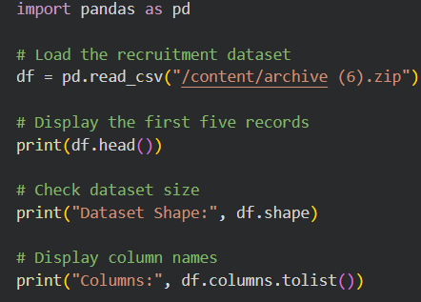
Data Collection
Recruitment data is imported from a CSV file using the Pandas read_csv() function.
1
The dataset is loaded into a DataFrame, providing a structured, tabular format for analysis.
2
Initial inspection is carried out using functions such as head(), tail(), and info() to understand the data.
3
This step ensures the dataset is correctly loaded before any cleaning or analysis begins.
4

Slide 8
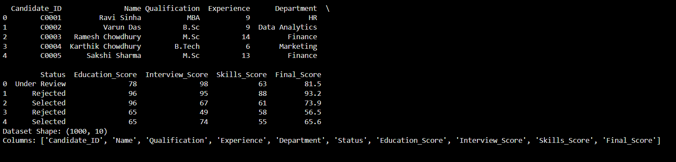
Output:

Slide 9
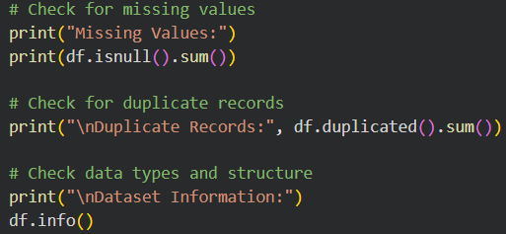
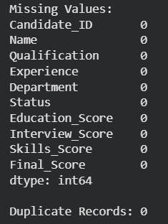
Data Preprocessing: Cleaning
Missing values are identified using isnull().sum() and handled through removal or suitable imputation.
1
Duplicate candidate records are detected and removed using drop_duplicates() to avoid skewed results.
2
Outliers in numerical attributes, such as experience or evaluation score, are examined to prevent distortion of results.
3
Cleaning ensures the dataset is accurate, consistent, and reliable for further analysis.
4

Slide 10
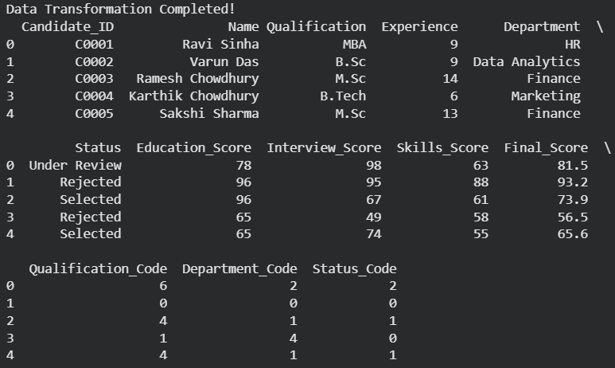
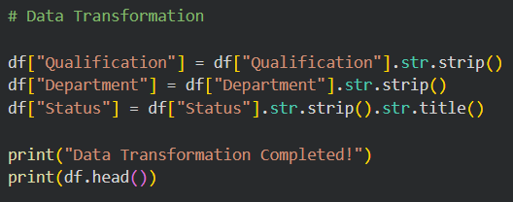
Data Preprocessing: Transformation
Removed extra spaces from text columns.
Standardized Status formatting using title case.
Encoded Qualification, Department, and Status into numeric codes.
Dataset now has 13 columns, ready for analysis and modelling.

Slide 11
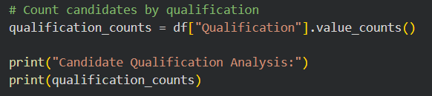
CANDIDATE QUALIFICATION ANALYSIS
This analysis focuses on the educational qualifications of candidates.
1
Our dataset contains a column called Qualification.
2
We want to know how many candidates belong to each qualification.
3

Slide 12
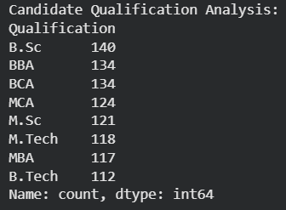
OUTPUT
140
112
B.Sc is the most common qualification — 140 candidates.
B.Tech is the least common — 112 candidates.
The qualification counts are relatively close, ranging from 112 to 140.
This means there isn't an extremely large concentration in a single qualification.

Slide 13
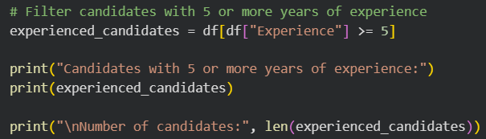
EXPERIENCE-WISE FILTERING
Here we are applying a condition-based filter. We check the Experience column and select only candidates with 5 or more years of experience. Out of the 1,000 candidates, 673 satisfy this condition, which is 67.3%. The important point is that Pandas filters the rows but keeps all the original columns, so we can still see the complete information of these shortlisted candidates.”

Slide 14
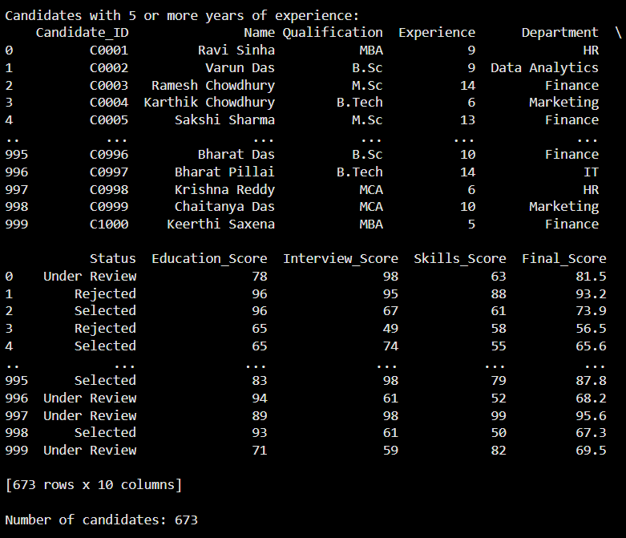
OUTPUT:
Condition applied: Experience >= 5.
673
327
673 candidates matched the condition.
327 candidates did not meet the condition.
67.3%
67.3% of candidates have 5+ years of experience.
All 10 candidate attributes are retained after filtering.

Slide 15
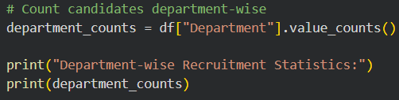
DEPARTMENT-WISE RECRUITMENT STATISTICS
df["Department"] selects the Department column from our dataset.
1
.value_counts() counts how many candidates belong to each department.
2
The result is stored in department_counts.
3
Then print() displays those counts.
4

Slide 16
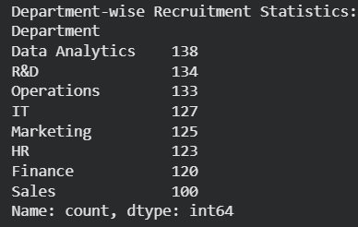
OUTPUT
1,000
138
100
1,000 candidates analyzed across 8 departments .
Data Analytics has the highest count: 138
Sales has the lowest count: 100
Candidate distribution varies by department.
Department-wise counts help identify areas with relatively higher or lower applicant representation.

Slide 17
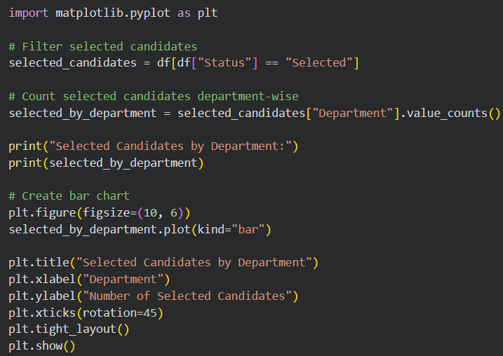
VISUALIZATION
1)BAR CHART (SELECTED CANDIDATES):
This analysis filters the dataset to identify candidates whose status is “Selected.”
1
The selected candidates are then grouped according to their department and counted.
2
A bar chart is used to compare the number of selected candidates across different departments.
3
This visualization helps us understand the department-wise distribution of selected candidates and makes it easier to compare recruitment outcomes between departments.
4

Slide 18
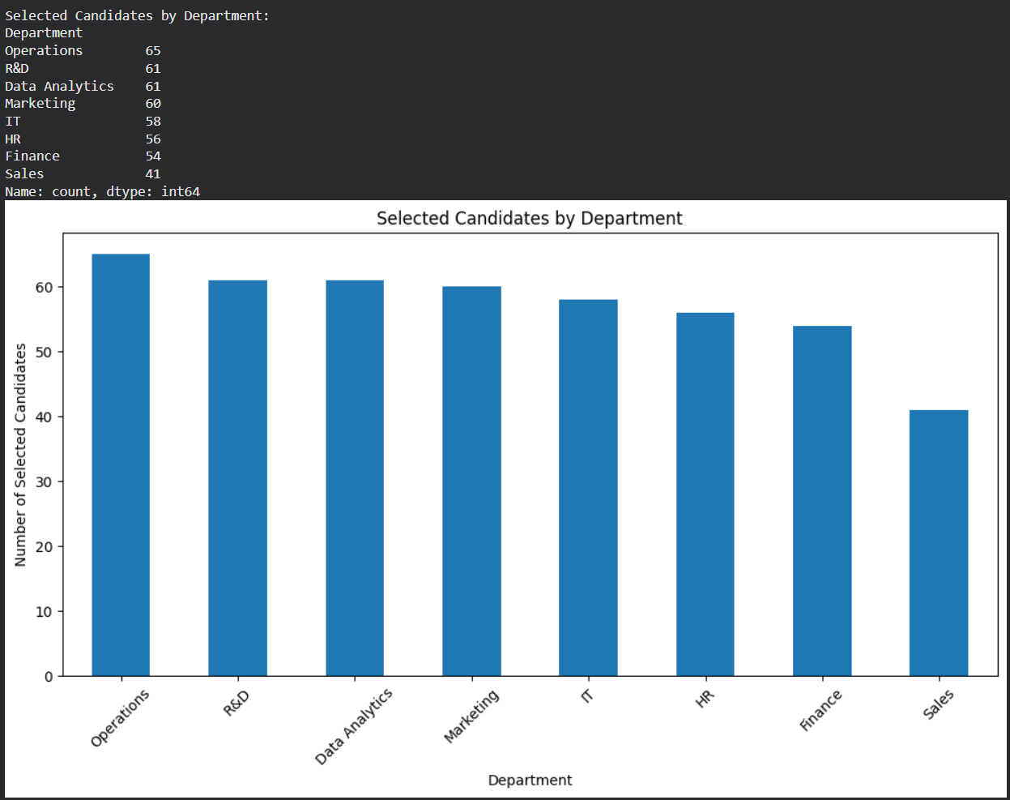
OUTPUT
It shows the distribution of selected candidates across the analyzed categories.
It helps identify which categories contribute more selected candidates.
It makes comparison between categories easier than looking at raw data.

Slide 19
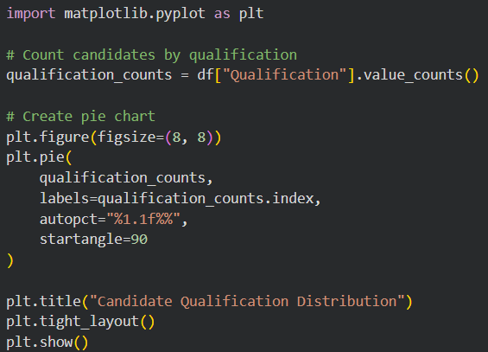
2)PIE-CHART(QUALIFICATION DISTRIBUTION):
This analysis counts the number of candidates in each qualification category using the Qualification column.
1
A pie chart is created to represent the distribution of candidates across different qualifications.
2
The percentage of each qualification is displayed on the chart, making it easy to understand the proportion of candidates belonging to each qualification category.
3

Slide 20
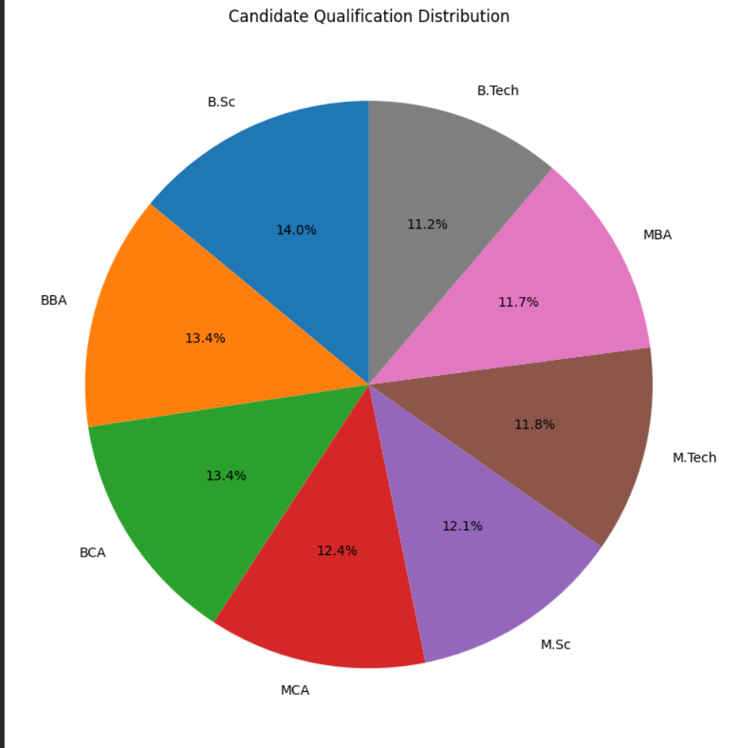
OUTPUT
14%
B.Sc has the highest representation — 14% of candidates.
11.2%
B.Tech has the lowest representation — 11.2%.
The other qualifications are fairly close in proportion, ranging from about 11.7% to 13.4%.
So, the dataset has a relatively balanced distribution of candidates across qualifications.

Slide 21
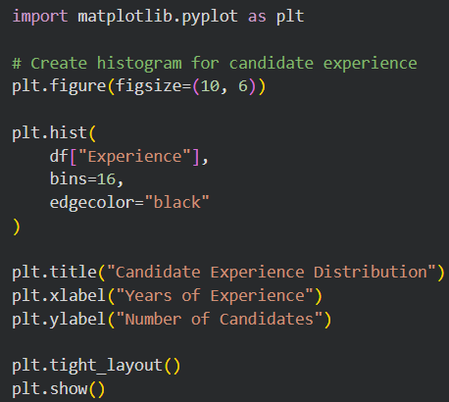
3)HISTOGRAM(EXPERIENCE):
This code creates a histogram to analyze the distribution of candidates based on their years of experience.
1
The experience values are divided into 16 intervals (bins), and the number of candidates in each interval is displayed.
2
This helps us understand the experience pattern of candidates and identify which experience ranges have more candidates.
3

Slide 22
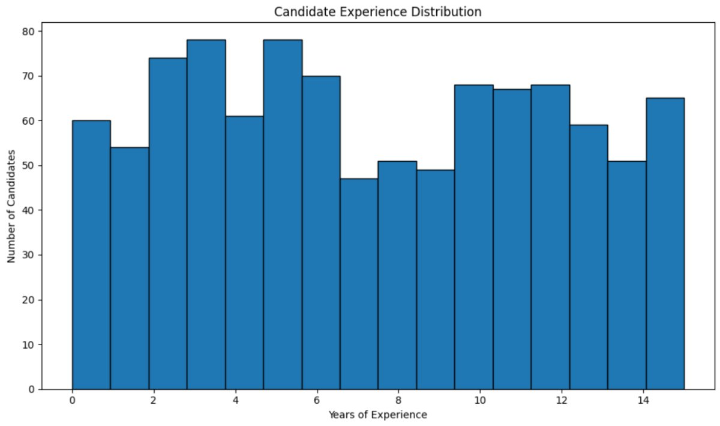
OUTPUT
67.3%
673 out of 1000 candidates (67.3%) have 5 or more years of experience.
This shows that a majority of candidates are experienced.
The histogram helps us see how candidates are distributed across different experience ranges.
It can be useful for shortlisting candidates based on experience.

Slide 23
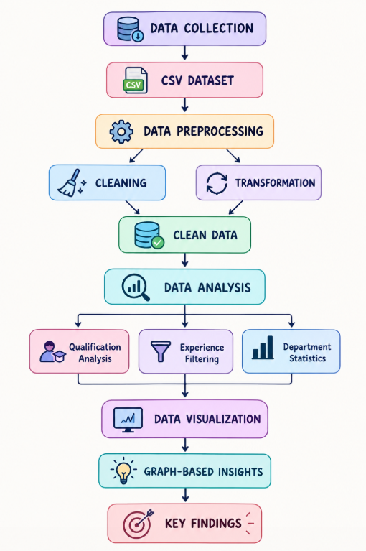
WORKFLOW
CLEANING
DATA COLLECTION
CSV DATASET
DATA PREPROCESSING
CLEAN DATA
TRANSFORMATION
Qualification Analysis
DATA ANALYSIS
Experience Filtering
DATA VISUALIZATION
GRAPH-BASED INSIGHTS
KEY FINDINGS
Department Statistics

Slide 24
KEY FINDINGS
1,000
1,000 candidates analyzed across 8 departments.
67.3%
67.3% candidates have 5+ years of experience.
138
Data Analytics recorded the highest candidates — 138.
100
Sales recorded the lowest candidates — 100.
14%
B.Sc had the highest qualification representation — 14%.
11.2%
B.Tech had the lowest — 11.2%.
Candidate distribution across qualifications was relatively balanced.
Visualizations revealed clear experience, qualification, and department-wise trends.

Slide 25
CONCLUSION
The project demonstrates how Python and Pandas can simplify HR recruitment data analysis.
Data preprocessing helped us make the recruitment dataset clean, consistent, and suitable for analysis.
1
2
The analysis identified important patterns in qualification, experience, and department-wise candidate distribution.
Visualizations such as bar charts, pie charts, and histograms make recruitment trends easier to understand.
3
4
Filtering candidates based on experience and analyzing evaluation-related attributes can support systematic candidate assessment.
Overall, the system provides a structured, data-driven approach to recruitment analysis, reducing dependence on manual examination of large candidate datasets.
5
6

Slide 26


